Slide 1
Session 7
Exception Handling

Slide 2
Exception Handling in Java
Exception handling in Java allows programmers to deal with abnormal or unexpected situations that may occur during the program's execution.
It provides a structured approach to handle errors gracefully, preventing the program from terminating abruptly.
Graceful termination of the program exception handling plays an important role

Slide 3
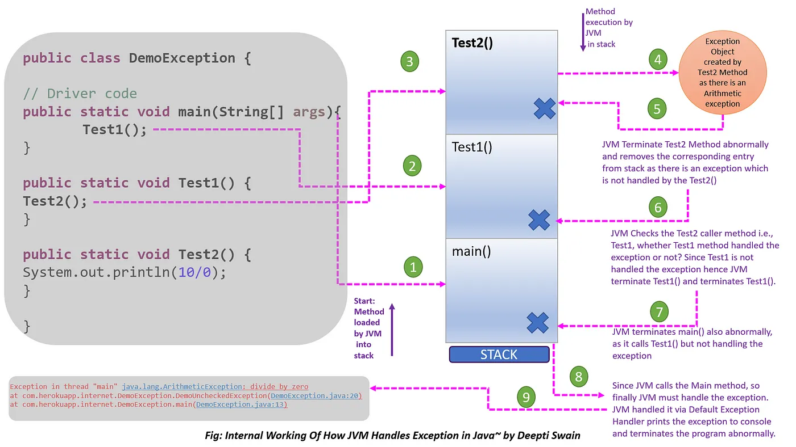
Default Exception Handling in Java by JVM:
Refer https://interviewnoodle.com/exception-in-java-89a0b41e0c45

Slide 4
Exception handling by Programmer using code:
Try-Catch Block
The `try-catch` block is used to catch exceptions and handle them appropriately. Syntax: try { // Code that may throw an exception } catch (ExceptionType1 e1) { // Exception handling for ExceptionType1 } catch (ExceptionType2 e2) { // Exception handling for ExceptionType2 } finally { // Optional block executed regardless of an exception }

Slide 5
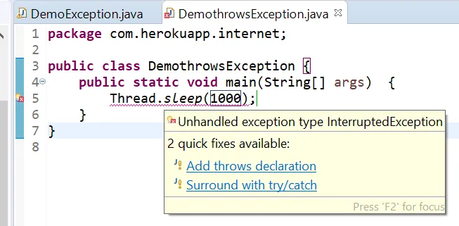
Throwing Exceptions
throw keyword Java allows programmers to manually throw exceptions using the `throw` keyword. Syntax: if (condition) { throw new SomeException("Error message"); }
throws keyword:
We can use throws keyword to delegate the responsibility of exception handling to JVM or any other method.

Slide 6
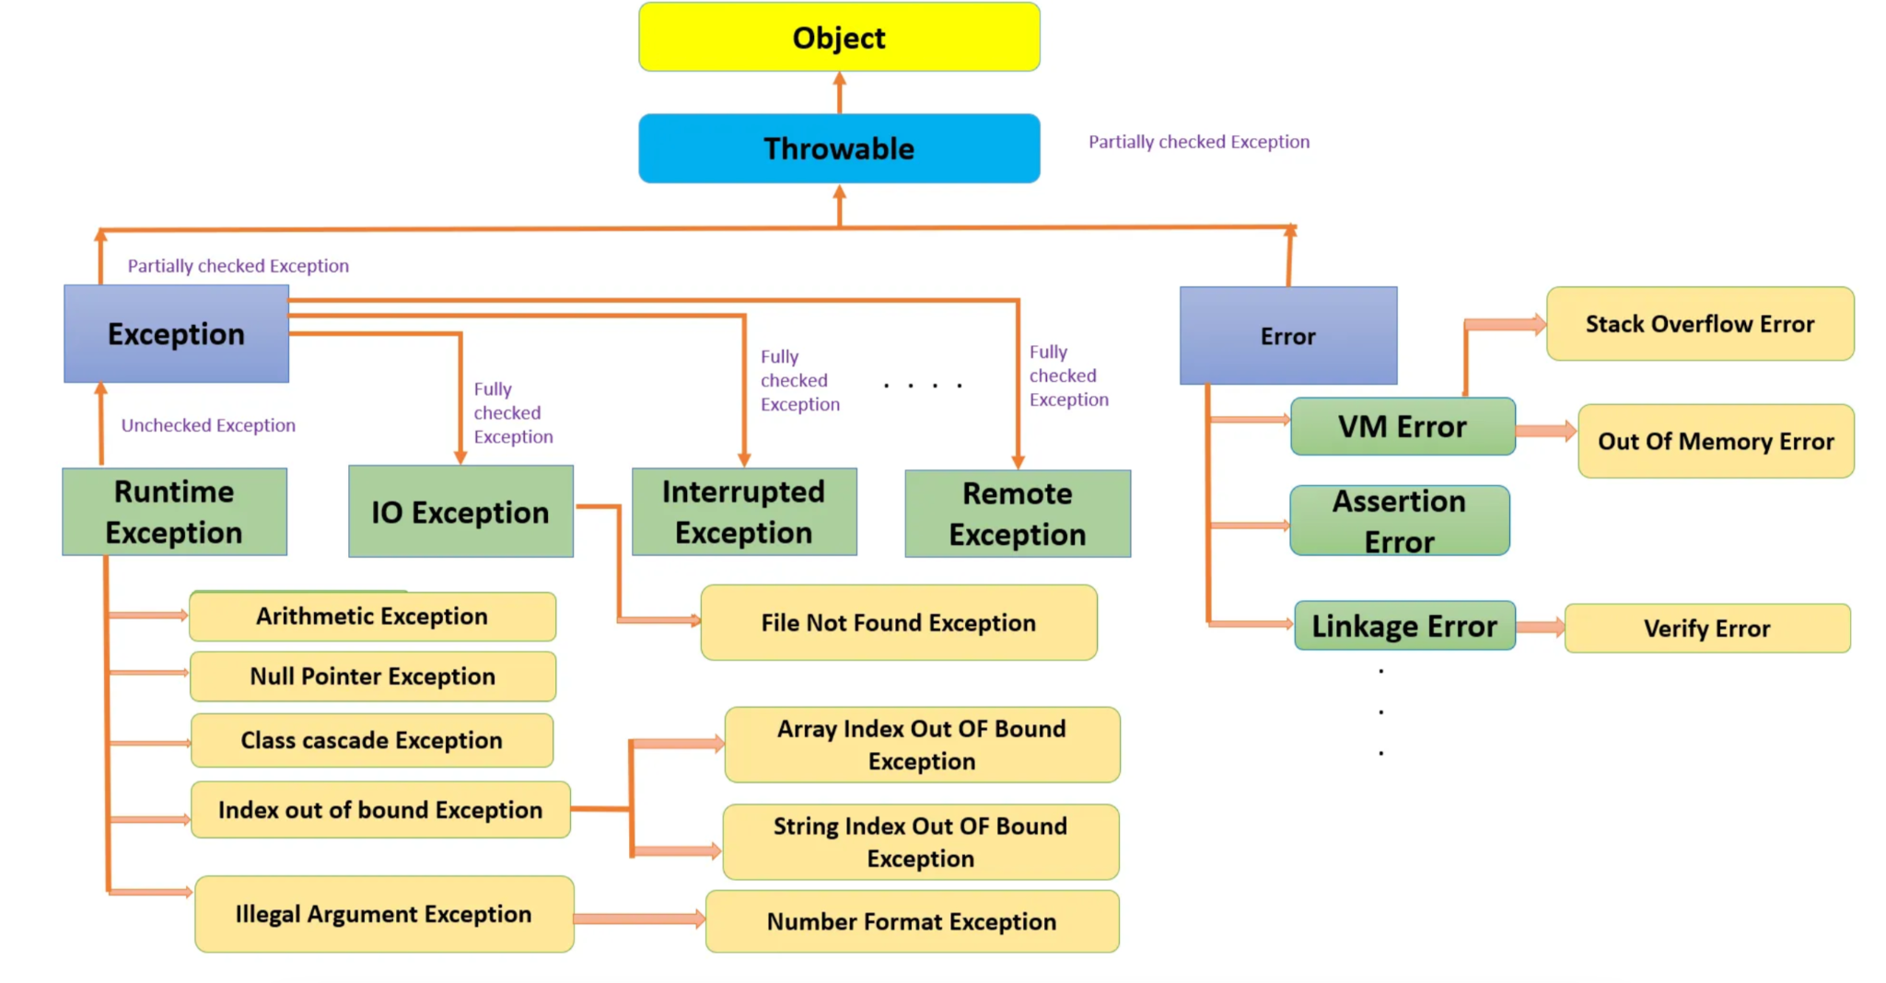
Checked and Unchecked Exceptions
Java has two types of exceptions: checked and unchecked. Checked exceptions are checked at compile-time and must be handled explicitly with a `try-catch` block or declared in the method signature using the `throws` keyword. Unchecked exceptions (RuntimeException and its subclasses) are not required to be caught or declared in the method signature.

Slide 7
Custom Exception Classes
Java allows creating custom exception classes by extending the `Exception` or `RuntimeException` class. Custom exceptions can be used to represent application-specific errors.

Slide 8
Feature Changes in Newer Versions of Java
Java 7 Multiple Exception Handling: In Java 7, you can catch multiple exceptions in a single `catch` block using a vertical bar (`|`). try { // Code that may throw exceptions } catch (IOException | SQLException e) { // Handle both IOException and SQLException }

Slide 9
Java 8
The `try-with-resources` statement: Introduced in Java 8, it simplifies resource management (e.g., file streams) by automatically closing resources after their use, regardless of whether an exception occurs or not. try (ResourceType resource = new ResourceType()) { // Code that uses the resource } catch (Exception e) { // Exception handling }

Slide 10
Java 9
Improved `try-with-resources`: In Java 9, the try-with-resources statement allows effectively final resources, meaning resources declared outside the try-with-resources block can be used. ResourceType resource = new ResourceType(); try (resource) { // Code that uses the resource } catch (Exception e) { // Exception handling }

Slide 11
Java 10
Local Variable Type Inference: In Java 10, the `var` keyword can be used for the resource variable in the try-with-resources statement, reducing code verbosity. try (var resource = new ResourceType()) { // Code that uses the resource } catch (Exception e) { // Exception handling }

Slide 12
Java 14
`Throwable.getMessage()` Improvement: In Java 14, the `getMessage()` method of the `Throwable` class returns a concise exception message that excludes the exception class name. try { // Code that may throw an exception } catch (Exception e) { System.out.println(e.getMessage()); // Output: "Error message" }

Slide 13
Java 15
`NullPointerException.getMessage()` Improvement: In Java 15, the `NullPointerException` class has a more descriptive error message indicating the name of the variable that is `null`. String name = null; try { System.out.println(name.length()); } catch (NullPointerException e) { System.out.println(e.getMessage()); // Output: "Cannot invoke "String.length()" because "name" is null" }

Slide 14
Keynotes
Exception Handling in Java
- Exception handling in Java allows the program to handle unexpected situations or errors gracefully without terminating abruptly.
- Exceptions are objects that represent abnormal conditions that occur during program execution.
Types of Exceptions
- Checked Exceptions: These are checked at compile-time and must be handled using try-catch or declared using throws in the method signature.
- Unchecked Exceptions (RuntimeException): These are not checked at compile-time. They include arithmetic exceptions, null pointer exceptions, etc.
Exception Handling Keywords
- try: Defines a block of code where exceptions might occur.
- catch: Catches and handles specific exceptions within the try block.
- finally: Contains code that will execute regardless of whether an exception occurred or not.
- throw: Explicitly throws an exception using a specified exception type.
- throws: Specifies that a method may throw a certain type of exception.
Catching Exceptions
- Use `catch` to catch and handle specific exceptions.
- Multiple `catch` blocks can be used for different exception types.
- `catch` blocks are evaluated in the order they appear, so more specific exceptions should come before more general ones.
The `finally` Block
- The `finally` block is used to contain code that should be executed regardless of whether an exception occurred or not.
- It's often used for cleanup tasks like closing resources.
The `try-with-resources` Statement
- Introduced in Java 7, it automatically closes resources like files, streams, etc., after they are no longer needed.
- Resources should implement the `AutoCloseable` interface.
Custom Exception Classes
- You can create custom exception classes by extending the built-in `Exception` class or its subclasses.
- Custom exceptions can represent application-specific errors and provide meaningful error messages.

Slide 15
Exception Propagation
- If an exception is not caught in a method, it is propagated to the calling method.
- If an exception is not caught in the main method, the program terminates, and the exception is printed.
Best Practices
- Catch exceptions at an appropriate level in your application.
- Provide meaningful error messages to aid in debugging.
- Use the try-catch-finally block when working with resources like files and streams.
- Handle exceptions gracefully to ensure the application remains responsive.
Exception Handling in Multi-Layered Applications
- Exception handling becomes crucial in multi-layered applications.
- Handle exceptions in a way that separates concerns and provides meaningful feedback to the user.

